Slide 1
Sea Level Rise Training
2024 National Hydraulic Engineering Conference

Slide 2
Brief Science Review
Ocean Expansion
Ice caps melting
Vertical Land Movement
Notes:
Three of the leading causes of sea level rise include Ocean Expansion, Ice Caps melting and Vertical Lands Motion. More information can be found about each of these in HEC-25 Chapter 4.

Slide 3
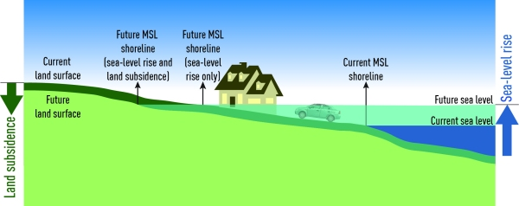
Relative Sea Level Rise
Notes:
Above is a depiction (taken from google) depicting relative sea level rise. The picture shows the water levels rising and the land elevation lowering. The net result is that the water rising is even greater relative to the fixed point of the infrastructure.
Relative sea level rise is the value needed for infrastructure design, not global sea level rise.
Animation credit: NIWA: https://niwa.co.nz/hazards/coastal-hazards/sea-levels-and-sea-level-rise

Slide 4
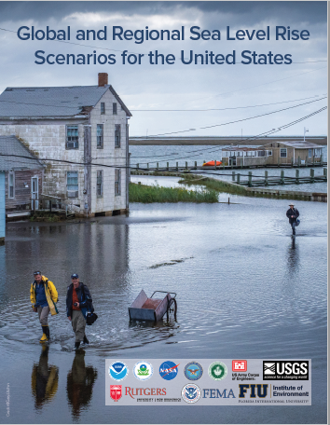
NOAA 2022 SLR Report
Notes:
The latest science regarding sea level rise estimates can be found in the NOAA 2022 Sea Level Rise Report. This is an excellent source that provides the state of the science as well as specific SLR estimates.
Screenshot of NOAA Interagency 2022 SLR Report

Slide 5
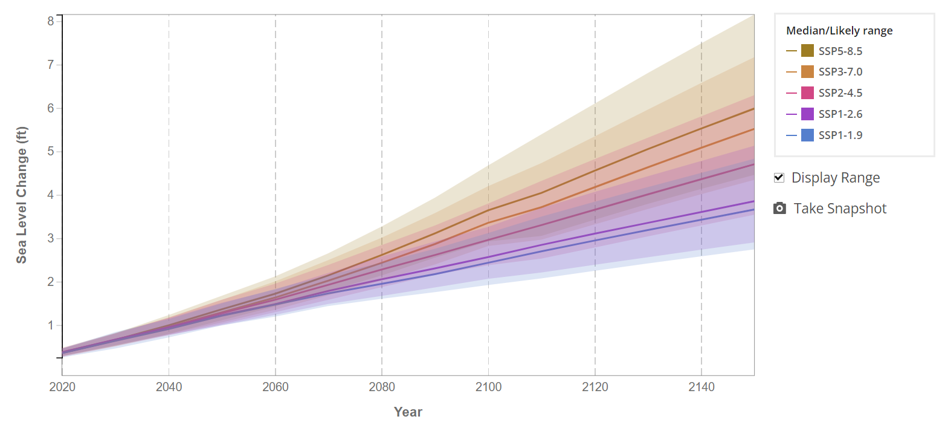
AR6 Scientific Estimates
Notes:
This is an example of SLR projections from the AR6 estimates. The AR6 estimates are the SLR values derived from the various science models that predict sea level rise. These scientific models all have different predictions, so the ranges of these predictions are shown from the various model estimates (ie some models may predict high sea level rise values while other may predict lower increases in sea level rise).
Screenshot from NASA Sea Level Rise Viewer.

Slide 6
Interagency Planning Scenarios
Notes:
The interagency planning scenarios were developed to span range of scientific possible scenarios. However, the values on these scenarios are arbitrary. They are just spaced to cover the range of potential sea level rise values evenly.
Screenshot from 2022 NOAA Interagency Sea Level Rise Report

Slide 7
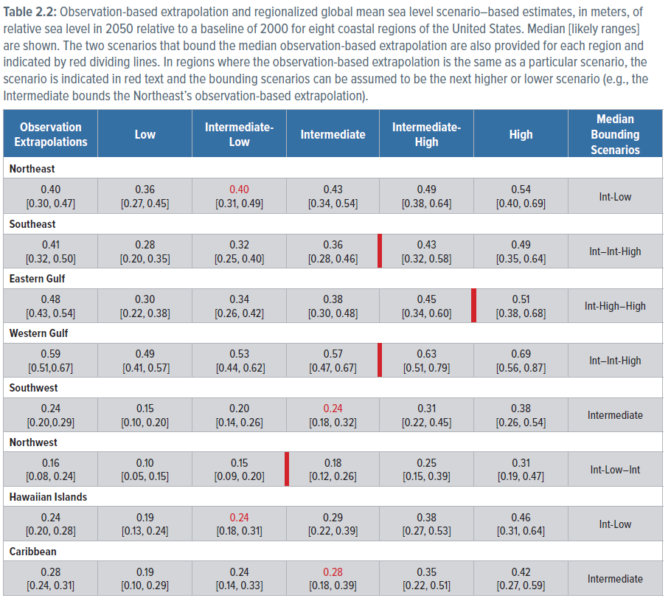
Science and Planning Scenario Relationships
Notes:
This is a graphic from the NOAA interagency report, helping explain the relationship between the AR6 and Interagency Planning Scenarios. It shows that the AR6 scientific estimates relate to different planning scenarios in different regions. For example, in the Hawaiian islands, the AR6 predicts a intermediate low scenario, while in the eastern gulf, it is almost a high prediction. This shows that the planning scenarios act almost as qualitative values, while the AR6 provides the scientific numbers.

Slide 8
Science and Planning Scenario Relationships
Notes:
Here is another table from the NOAA SLR report showing the relationship between the AR6 estimates and NOAA SLR Planning Scenarios. This shows which AR6 models under which emission forcings fall in which planning scenarios. As an example, for the High planning scenario, this is mostly the low confidence high emissions scenarios (low confidence, meaning they have less confidence in the science to predict the ice melting).

Slide 9
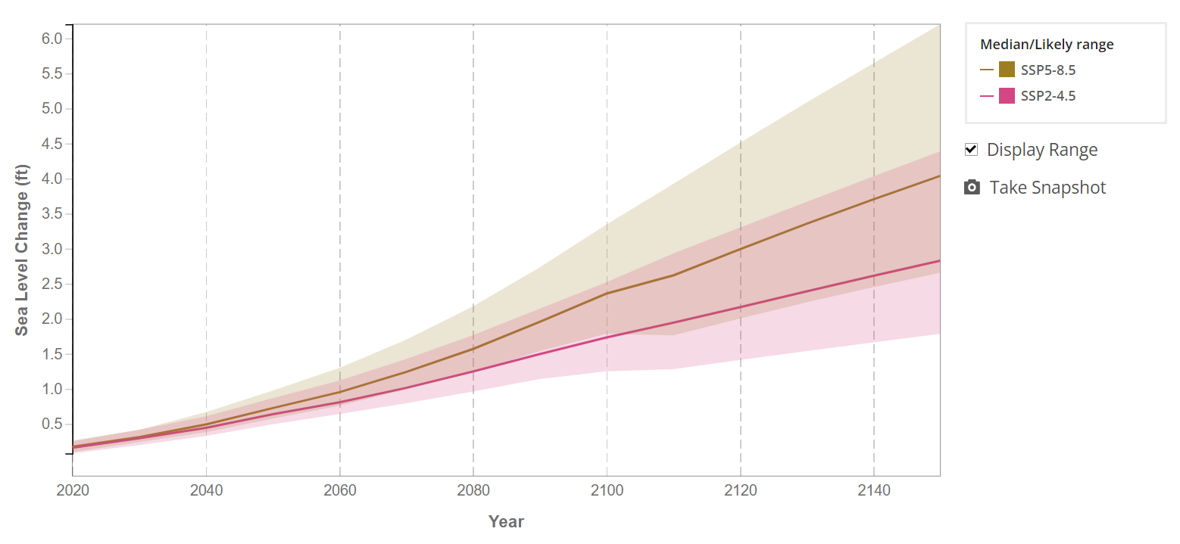
Selecting SSPs
Notes:
The SSPs represent the carbon emissions from society. An SSP will need to be assumed or anticipated in order to select a SLR value. Often it is good to select more than one SSP values to understand the range of possible SLR values.
Screenshot from NASA Sea Level Rise Viewer.

Slide 10
Deciding on Risk: HEC-25 Framework
What is the asset service life?
What is the damage risk to the asset?
What is the asset redundancy?

Slide 11
Low Risk Assets
Select the asset service life
Find the AR6 SSP2-4.5 Relative Sea Level Rise Value.
The HEC-25 table represents global sea level rise values. It can be used as a quick check mechanism.
Notes:
The represent Global Sea Level Rise values that should be considered for lower risk projects. More information about the SLR value selection framework can be found in HEC-25 3rd Edition Chapter 4, section 4.1.7.

Slide 12
High Risk Asset
Select the asset service life
Find the AR6 SSP5-8.5 Relative Sea Level Rise Value Upper 95% Confidence Limit. (Current Tool only gives 83rd upper percentile).
The HEC-25 table represents global sea level rise values. It can be used as a quick check mechanism.
Notes:
The represent Global Sea Level Rise values that should be considered for higher risk projects. More information about the SLR value selection framework can be found in HEC-25 3rd Edition Chapter 4, section 4.1.7.

Slide 13
Quick Probability Review
What is the chance a bridge with a 75 year service life will experience the 100 year(1% AEP) storm?
What is the chance one out of 5 bridges will experience the 100 year (1% AEP) storm during their service life?
Notes:
This activity is meant to demonstrate that designers often focus on the risk at a single project location. However, when implementing this programmatically across a State, the considerations for risk change. The probability that each individual bridge may experience a rare storm is small, but when considering the risk that one bridge out of many across the State may experience a rare storm, the probability is greater.

Slide 14
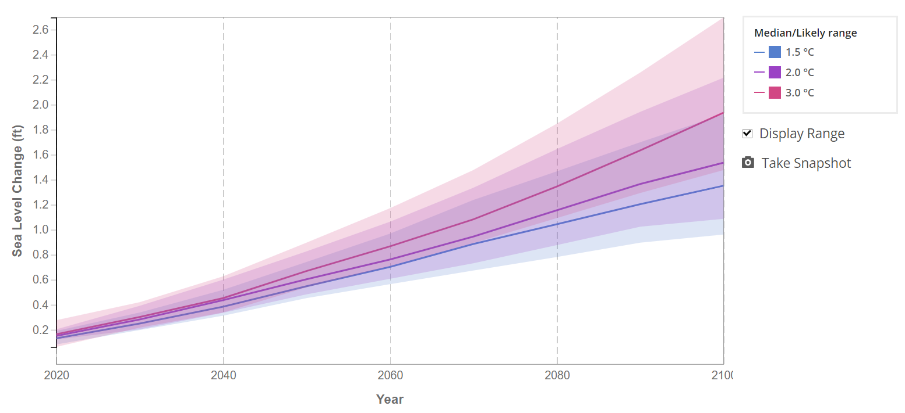
Linking to Temperatures
Notes:
There are benefits to tiring SLR values to global temperature increases instead of SSP scenarios. Tying an infrastructure asset to a global temperature is a simpler explanation of risk, than tying it to SSPs. For example, one could state, that bridge X can will pass the 100 year coastal storm, provided that global temperatures do not increase more than 2 degrees.
Screenshot from NASA Sea Level Rise Viewer.

Slide 15
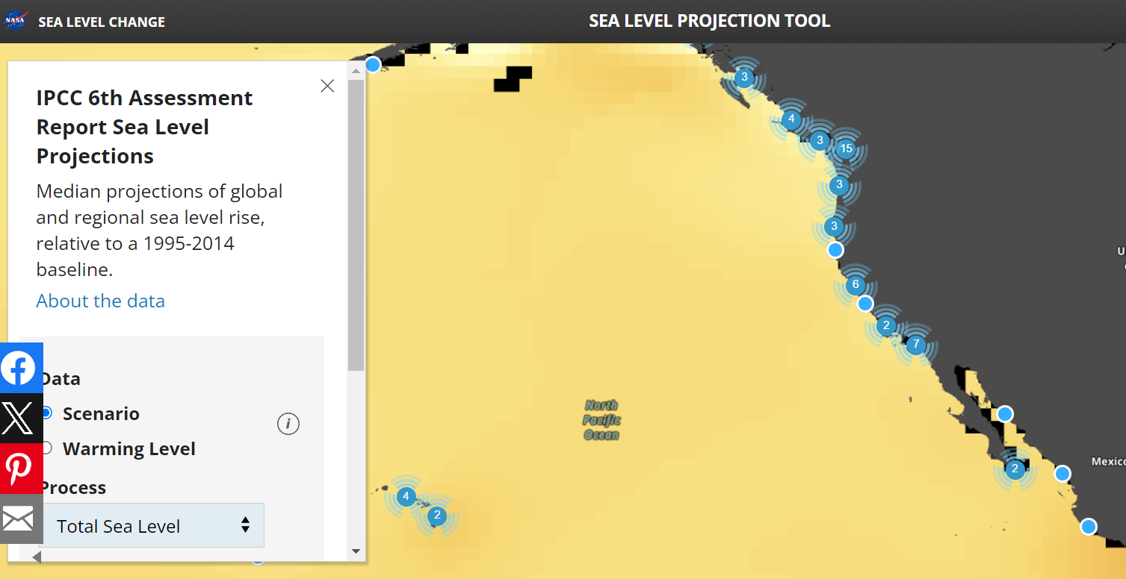
NASA Sea Level Rise Viewer
Notes:
The NASA Sea Level Rise viewer is an excellent tool to find sea level rise estimates.
Screenshot from NASA Sea Level Rise Viewer.

Slide 16

Sea Level Rise Activity

